Slide 1
Environmental impacts of globalization
Chapter 13

Slide 2
Bellwork
Read the Voices section on pg.263 of your text and answer the following questions
The report by the ICIJ states that North America is a prime target for the private water industry because only about 5 per cent of the water market is private. How do private water companies convince consumers and governments that private water operators do a better job of delivering water than public operators?
When water services are privatized and profits go to a private company rather than the government, what does the government have to do to make up for that lost revenue (income)?

Slide 3
Review
Privatization = the sale of government-owned industries and services to private businesses
So far we have discussed the consequences and impacts of privatization of consumer goods (wants). What happens when we begin privatization of necessities (needs)?

Slide 4
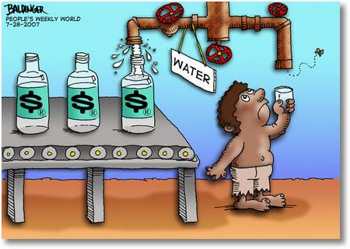

Slide 5
Ethics
Moral principles or values
Notes:
http://study.com/academy/lesson/environmental-ethics-human-values-definition-impact-on-environmental-problems.html

Slide 6
Implications
A suggestion that certain things are true or will happen as a result of something else

Slide 7
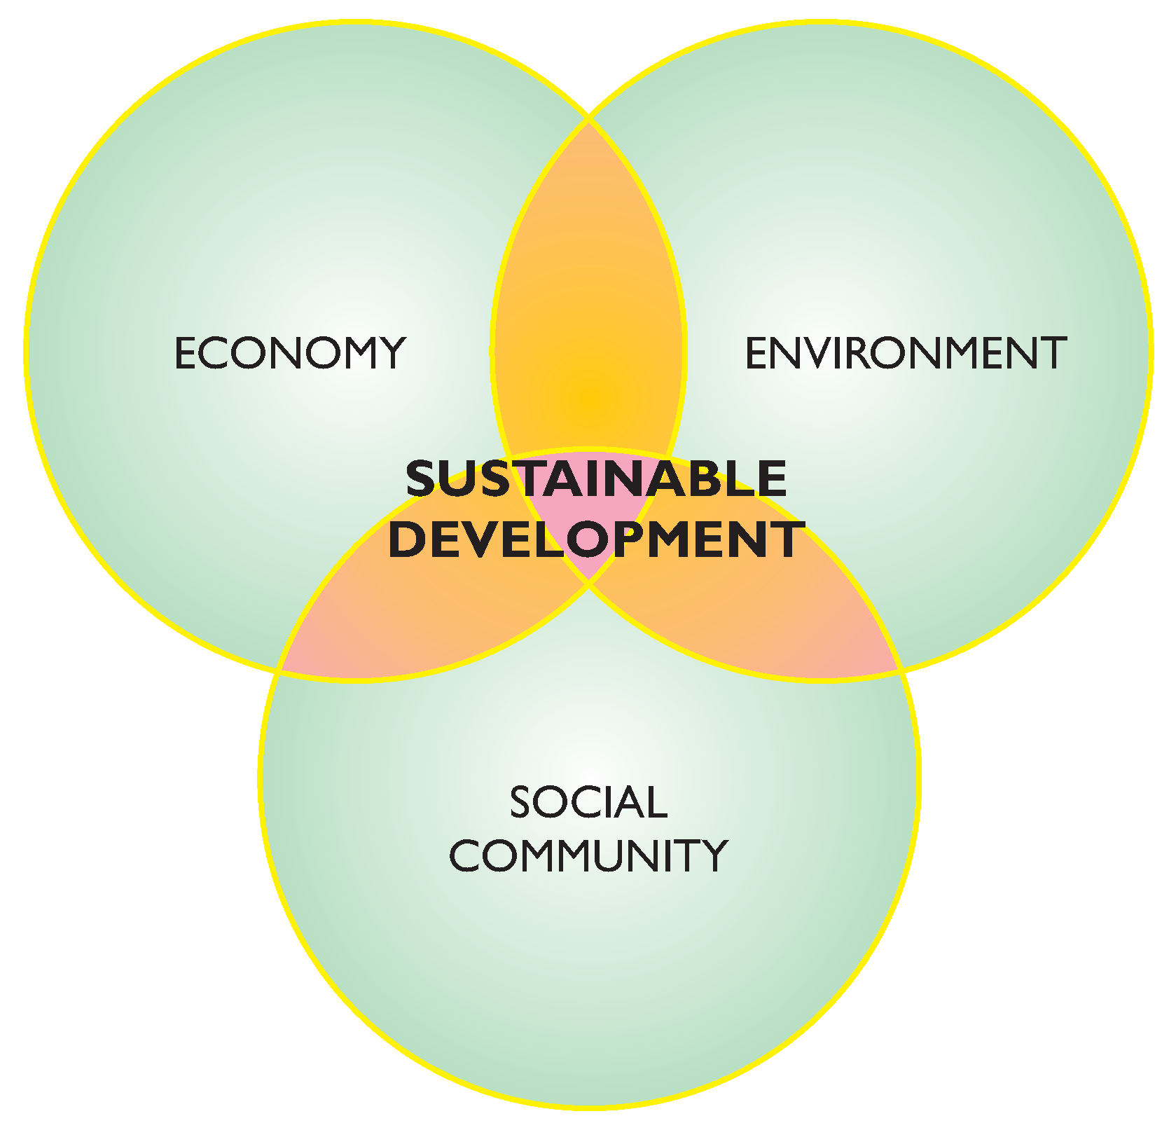
Sustainable Development
Development that meets the needs the present without compromising the ability of future generations to meet their own needs
Notes:
https://www.youtube.com/watch?v=3WODX8fyRHA

Slide 9
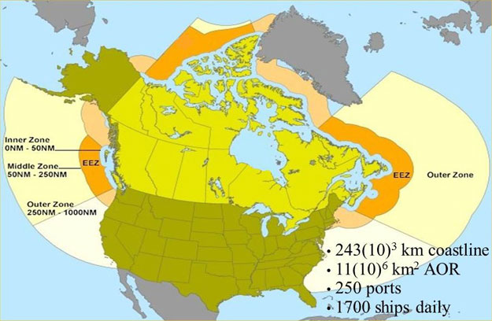
Exclusive Economic Zone
An area of sea around a country’s shoreline from which the country has the exclusive right to extract natural resources

Slide 12
What do you think?
Is there a way we can still grow our economies and take care of the planet at the same time?

Slide 13
Stewardship
Responsible management and use of land and resources so that future generations will enjoy healthy environments

Slide 14
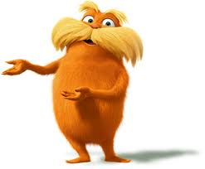
“I am the Lorax. I speak for the trees. I speak for the trees for the trees have no tongues.”
Notes:
https://www.youtube.com/watch?v=F3UNjNe5lD8

